Slide 1
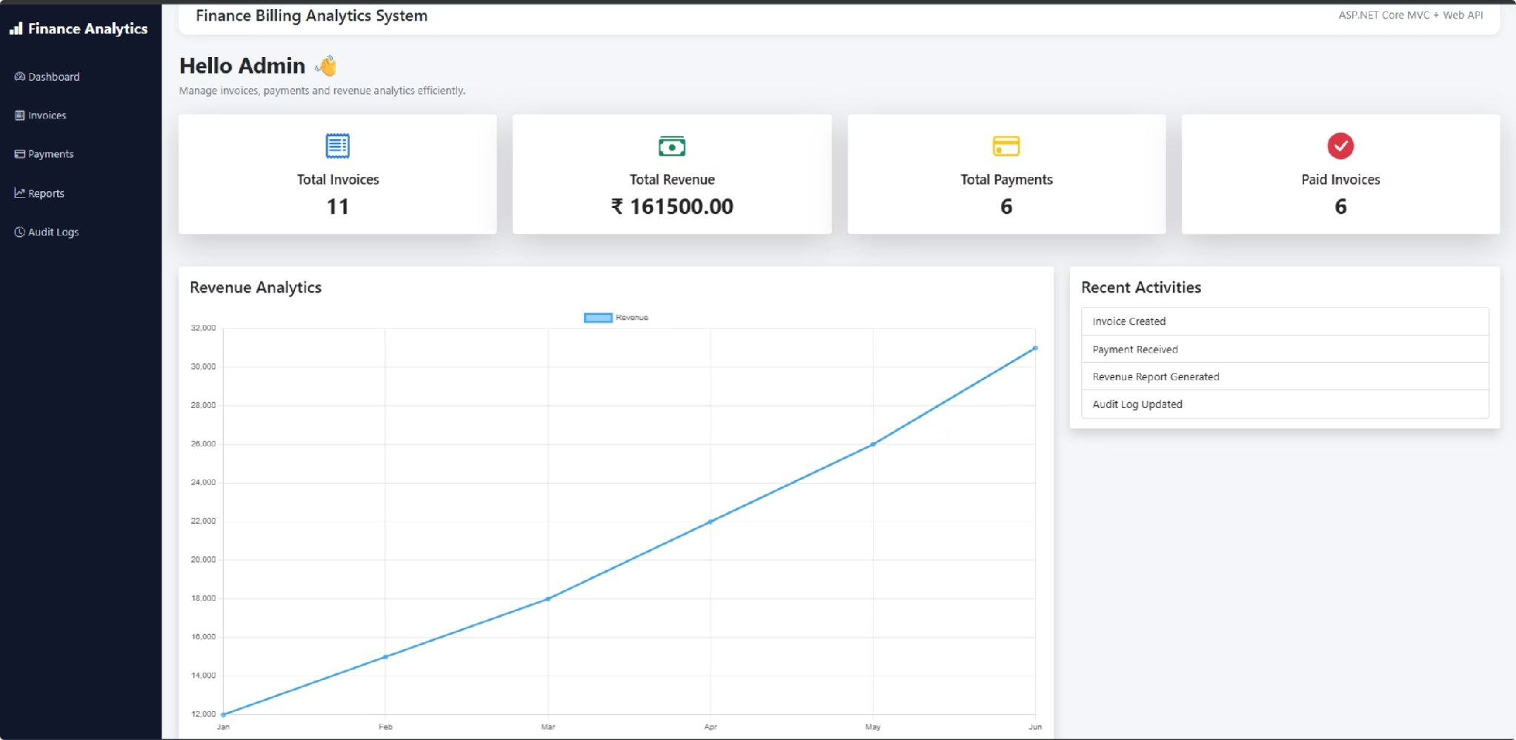
Finance Billing Analytics System
A full-stack, enterprise-grade billing platform built for accuracy, security, and real-time ﬁnancial insight.
MVC · WEB API · SQL SERVER · DOCKER · AZURE
CAPSTONE PROJECT PRESENTED BY : GIRIDHAR GOPAL

Slide 2
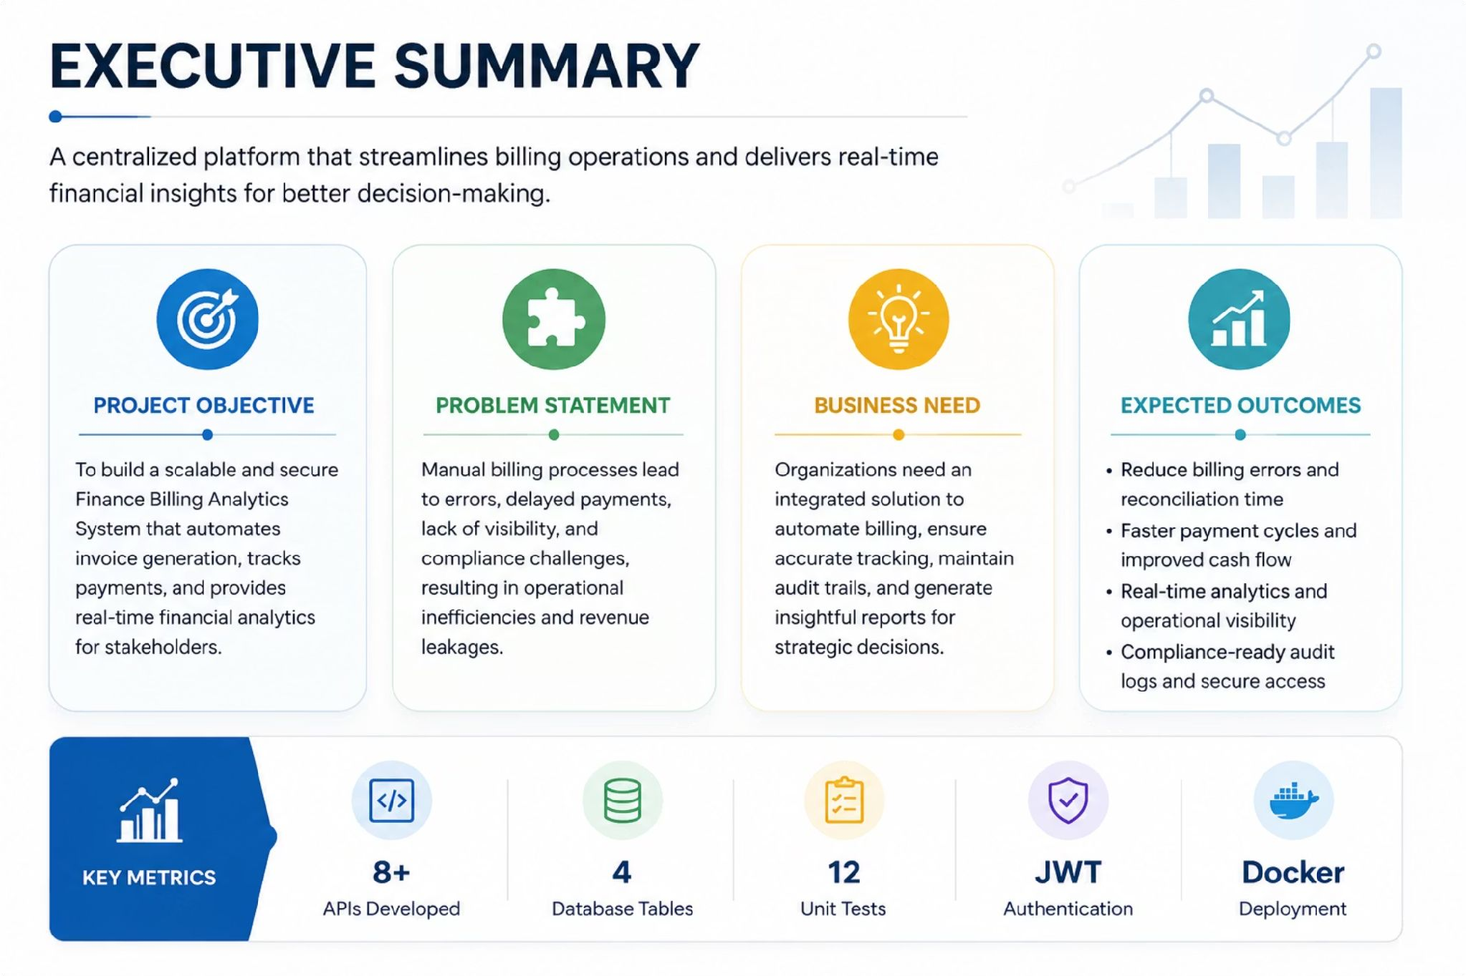
Executive Summary
Metric | Value
APIs Developed | 8+
Database Tables | 4
Unit Tests | 12
Authentication | JWT
Deployment | Docker

Slide 3






Project Overview
Objective
Primary Users
Key Beneﬁts
Faster workﬂows
Live reporting
Role-based access
Full auditability
Launch a secure billing platform that automates invoices, tracks payments, and surfaces ﬁnancial insights.
Built for ﬁnance teams, billing admins, auditors, and leadership.

Slide 4




Technology Stack
A modern, layered architecture built for performance, maintainability, and cloud readiness.
Backend
ASP.NET MVC & Web API with clean separation of concerns for scalable service design.
Data Layer
SQL Server with Entity Framework Core for ORM-based, type-safe data access.
Security
JWT token-based authentication with role-based authorization policies.
DevOps
Docker containerization and GitHub Actions CI/CD pipelines for automated deployment.

Slide 5
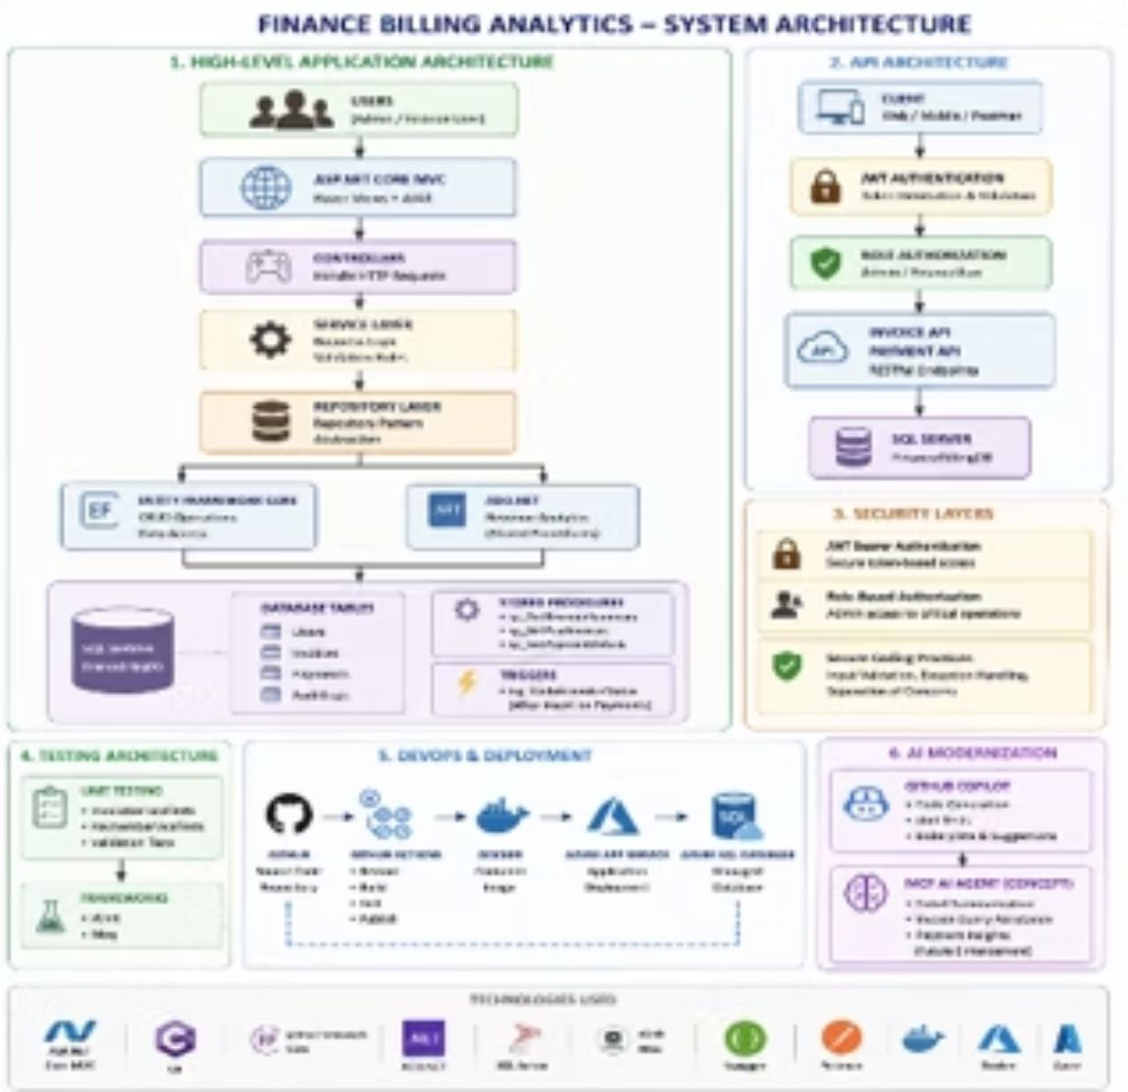
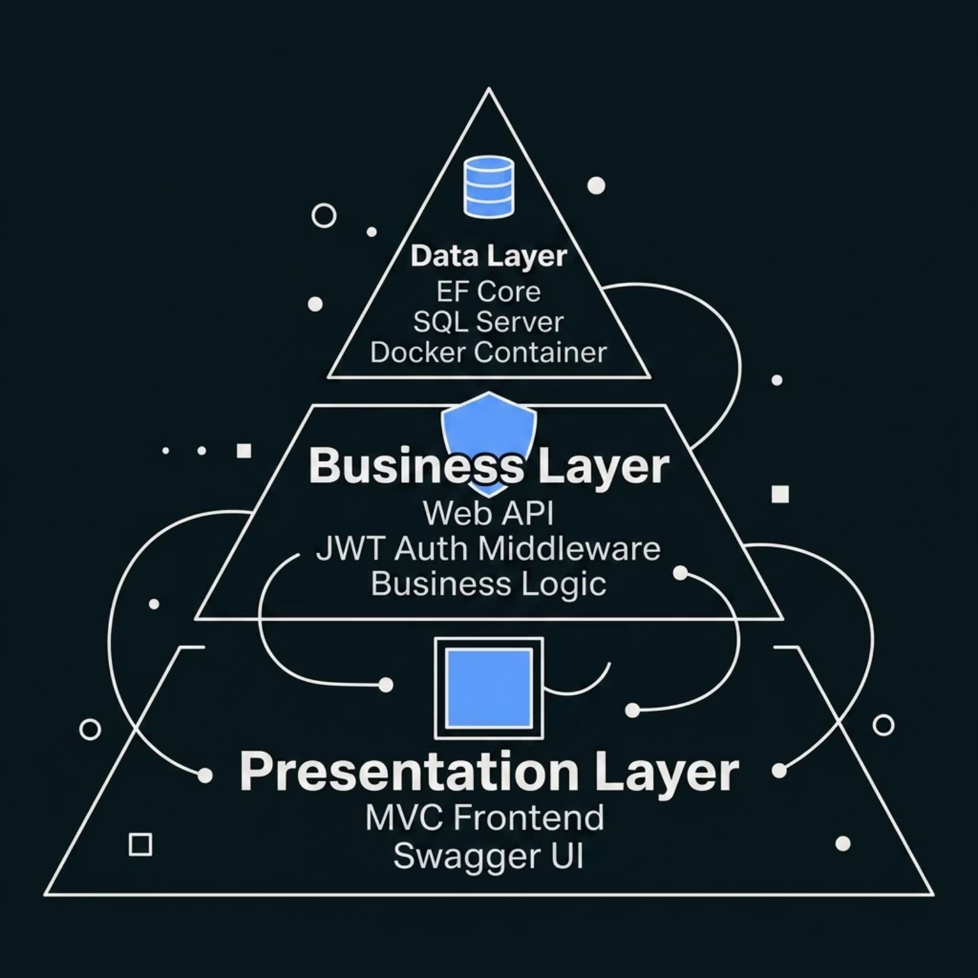

System Architecture
All inter-service communication is secured via HTTPS. The architecture supports horizontal scaling and Architecture designed to support future scalability and cloud deployment.

Slide 6
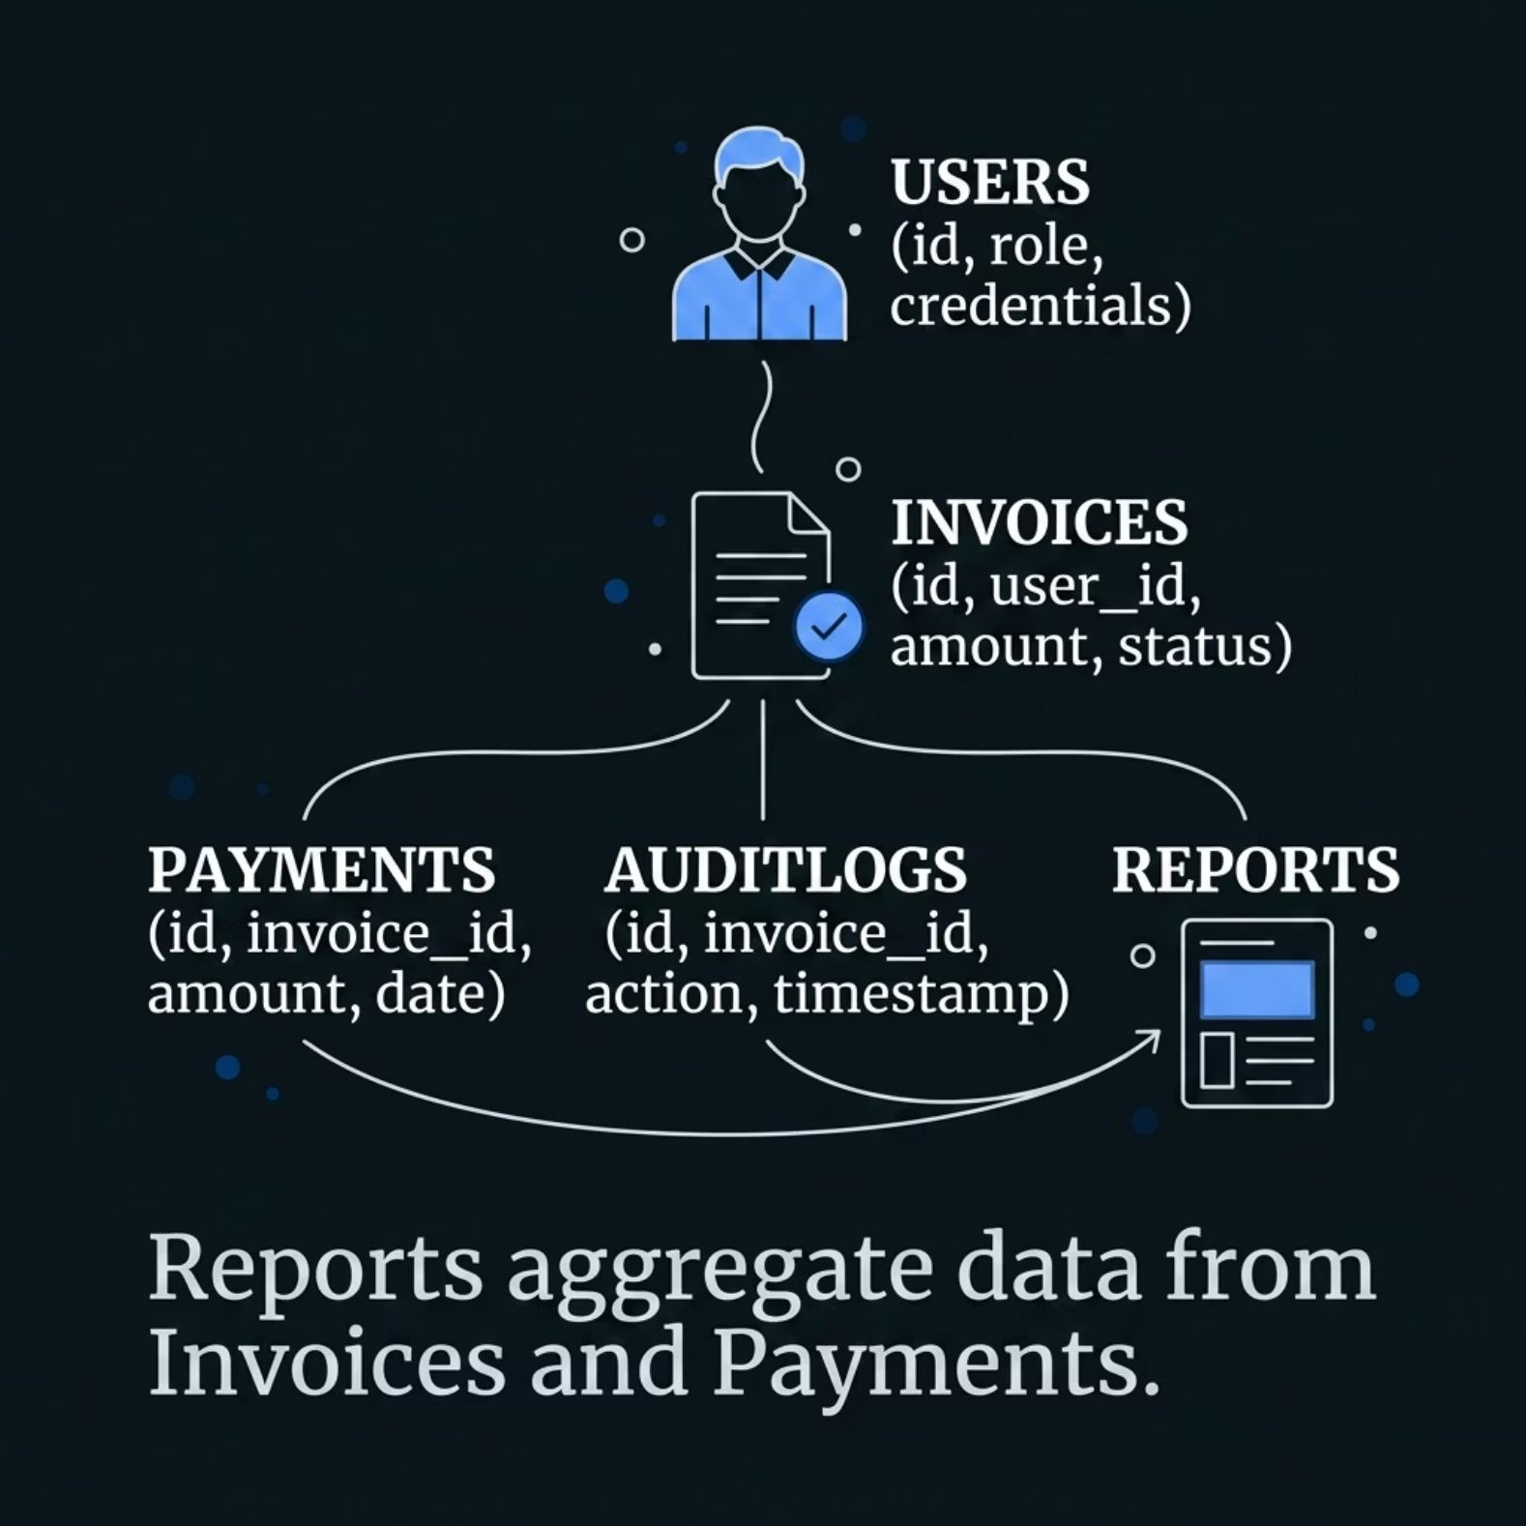
Database Design
Core Entities
· Users — Authenticated accounts with role assignments (Admin, Finance, Viewer)
Invoices — Line items, totals, status tracking, and due dates Payments — Linked to invoices with partial/full payment support AuditLogs — Immutable record of all system actions and changes Reports — Aggregated views for dashboards and exports
·
·
·
·
Foreign key relationships ensure referential integrity across all billing transactions.

Slide 7
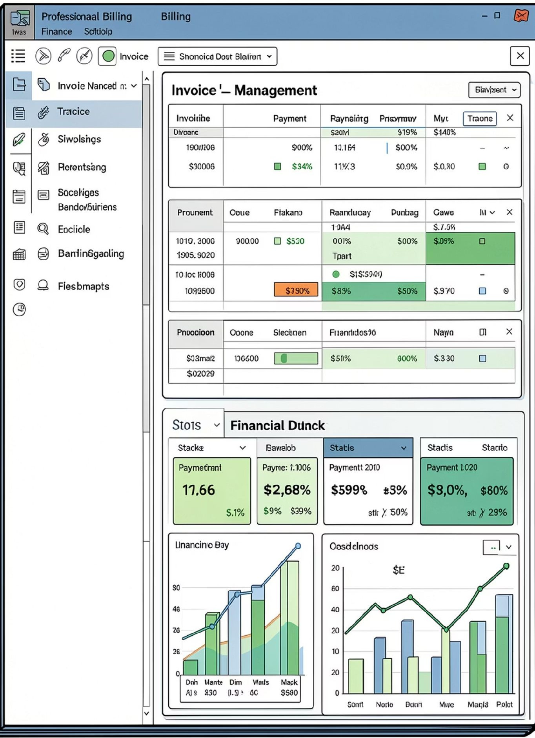




Core Features
Invoice Management
Create, edit, and track invoices with automated numbering, line items, and status workﬂows.
Payment Tracking
Real-time payment status updates with support for partial payments and reconciliation.
Reports & Dashboard
Visual KPIs, revenue summaries, and trend charts for executive-level ﬁnancial oversight.
Audit Logs & RBAC
Immutable action logs and granular role-based access control for compliance and security.

Slide 8

Security & API Testing
JWT Authorization Flow
Users authenticate via credentials; the server issues a signed JWT token. Every subsequent API request includes the token in the Authorization header, validated by middleware before granting access to protected resources.
Testing Tools
Swagger UI
Interactive API documentation with live endpoint testing and schema validation.
Postman
Collection-based testing for auth ﬂows, invoice CRUD, and payment scenarios.
Tokens are short-lived and refreshable, minimizing exposure risk.

Slide 9


DevOps Pipeline & Future Scope
Code Commit
Push changes to GitHub
Containerize
Build Docker image
Build & Test
CI runs via GitHub Actions
Deploy
Release to Azure cloud
Automated pipelines ensure every code change is built, tested, and deployed consistently — reducing release risk and accelerating delivery.
What's Next
The current architecture is cloud-ready — containerization via Docker and CI/CD via GitHub Actions lay the foundation for a seamless Azure transition.
·
·
·
Azure Cloud Migration — Scalable hosting with managed SQL and App Services
AI-Powered Analytics — Predictive billing trends and anomaly detection
Power BI Integration — Embedded executive reports and scheduled data exports

Slide 10

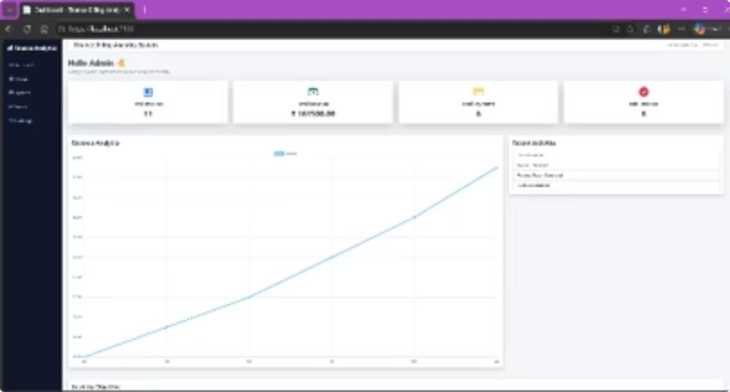
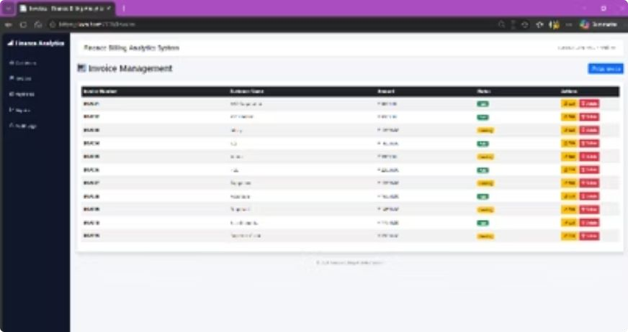
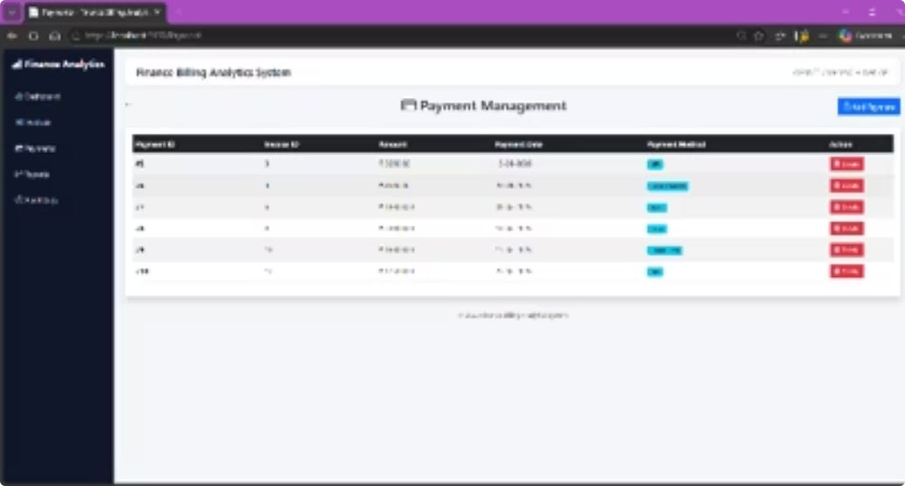
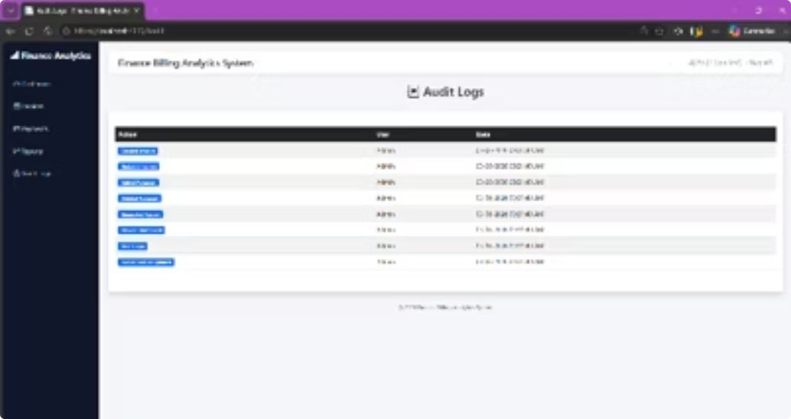
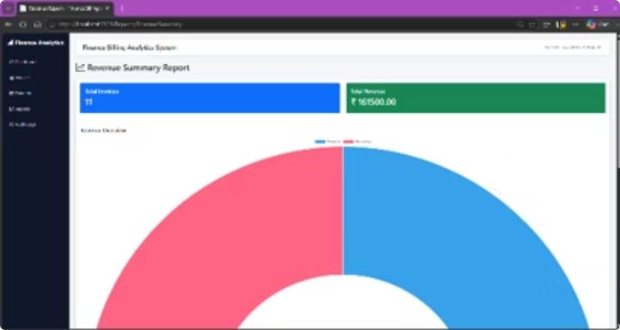
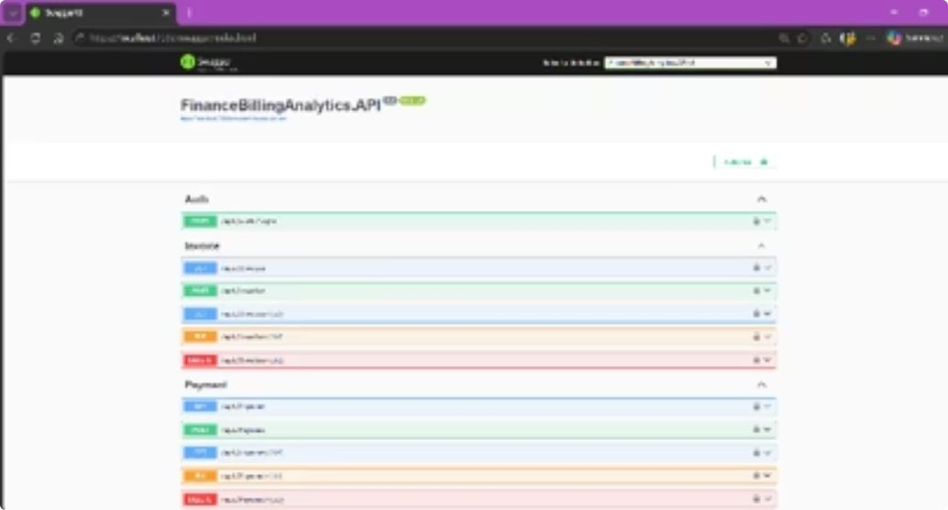
Dashboard & Application Screens
Dashboard Analytics:
Invoice Management:
Payment Tracking:
Audit Tracking:
Revenue Reporting:
Swagger API :
.

Slide 11
Key Learnings & Takeaways
1 2
3
Architecture Drives Scalability
Clear layers make the system easier to grow and adapt.
Security Is
Non-Negotiable
Build authentication, access control, and auditability in from day one.
DevOps Accelerates Delivery
Automation speeds releases and reduces deployment risk.
4
Testing Protects Reliability
Layered testing catches issues early and keeps releases stable.
Practical Takeaways
Design for change: Keep responsibilities isolated.
Build security early: Deﬁne access and audit rules upfront.
Automate delivery: Use CI/CD to ship faster with less risk.

Slide 12
Conclusion
The Finance Billing Analytics System is a successful, production-ready solution that brings together secure authentication, reliable APIs, real-time analytics, and automated deployment in one enterprise-grade platform.
Key Achievements
✔ Secure JWT Authentication & RBAC
✔ RESTful API with 8+ endpoints
✔ Real-time Revenue Analytics Dashboard
✔ Dockerized Deployment & CI/CD Automation
✔ Comprehensive Unit Testing (12 tests passed)
✔ Enterprise-grade Audit Logging
Project Impact
Demonstrates full-stack enterprise development
Production-ready architecture
Industry best practices implementation
Thank You
For further inquiries or a detailed demo:
Email: giridhargopal706@gmail.com
GitHub: https://github.com/Giridhar706/Finance-Billing_Analytics_System-Capstone

